Slide 2
Hands on training Non Clinical PKPD data exploration
Sven Hoefman
Tamara van Steeg
15 June 2022

Slide 3
Concepts

Slide 4
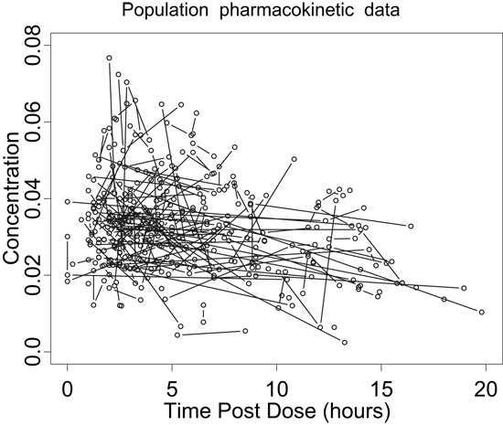
Population modelling: Illustrative example
Quantification of inter individual variability and residual error
Fictive example : Individual (line connections) PK profiles after single subcutaneous dose
Ka
Volume of distribution
CL
Exploration of covariate effects e.g. Different formulation with faster absorption
Difference observation
and individual prediction
measurement error
Outlier evaluation
Patients/Animals are different
Assays are subjected to error

Slide 5
PK-PD-Effect integrated modeling
Dose → Concentration → PD response → Clinical effect
Integrate pharmacokinetic, pharmacodynamic and physiological principles
Data integration
Across time points
Across doses
Across endpoints
Across studies, populations and species
Evaluate and quantify differences in patient populations (e.g. disease severity), species …
Analysis of sparse data is possible: Leverage information from rich (sub)studies
Across drugs
Sheiner (1992) Learning and confirming in clinical drug development, CPT

Slide 6
Population modeling as a tool to integrate and summarize PK-PD-Response knowledge
Population model as tool to answer questions
Try to capture the most important processes
Keep it as simple as possible
But not too simple
Helps summarize all available knowledge
Responses are described in a quantitative fashion
Information from different sources can be integrated
Allows data driven hypothesis testing
Model simulations
predictions can be used to explore untested situations to support decision making
Three main components of a population model
-PK: clearance (CL), volume of distribution (V) ...
-PD: production (Kin), degradation (Kdeg), drug effect ...
Structural
model
Explained inter individual variability:
-PK: CL, V increase with body weight
-PD: Kdeg decreases with body weight
-Compound specific effects to be investigated
Statistical
model
Covariate
model
-IIV: Unexplained inter individual variability
-Residual (measurement) error

Slide 7
Selection of model type depends on question, data and knowledge of the system
Purely descriptive -
often limited value in predictions
Straightforward reporting and interpretation
Model types
Non-compartmental models
Basic description of observations using linear regression
Descriptive compartmental models
A series of interconnected compartments without any physiological interpretation
Semi-mechanistic compartmental models
A series of interconnected compartments with some physiological interpretation
Systems pharmacology - physiologically based PK models
PBPK: A series of interconnected compartments where each compartment represents a specific organ
Align model type choice to
-question
-available data
-system knowledge
Often feasible to develop/update along with drug development
Discuss assumptions and limitations
Predictions possible within boundaries
Drug independent & systems based; High value predictions and extrapolation possible
Time consuming
(months to years)

Slide 8
Introduction to data exploration app

Slide 9
Practical information
Link to shiny data exploration application
Account creation invitation via email address
Live demonstration by Sven Hoefman: use of application
App developer (Richard Hooijmaijers) available online during course for help
App remains accessible for certain period of time to allow participants to complete / re-visit exercises

Slide 10
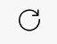
Data exploration shiny app: essentials
App designed for the present course: create explorative graphs for a dataset
All needed datasets are listed
Getting started
Select dataset: “sm_rat_pk_iv_sd.csv” (Optional: Click Table source data to get tabular overview)
Select plotting panel (Default plotting)
Select following in Layer 1 → X value: “TIME”; Y value: “Cplasma”
Click create plots
Expand settings as desired → Create plots to re-generate plot
Re-set settings to starting point via “Clear fields”
Alternative: create plot via “show presets”
Additional options
“Create plotly” instead of “create plots” → Interactive version of plot
Expert plotting: Allows more flexibility and plotting options → but less intuitive for users new to R programming
Save button to save plots
Complete refresh can be helpful:

Slide 11
Explanation of dataset column names
ID: animal number
TIME: time (h)
DOSE_MGKG: dose (mg/kg)
CMPD: compound (SM, mAb)
SPEC: species (Monkey, Rat, Mouse)
BW: body weight (kg)
ROUTE: route of administration (1: IV; 2: PO)
NDOS: number of doses
ADA: Animal anti drug antibody status (0: No; 1: Yes)
C: Concentration (µg/mL), e.g. Cplasma, Cbrain
BQL: Below quantification limit (0: No; 1: Yes)
DV: Dependent variable
BSL: Baseline (for efficacy and Safety biomarker)
Percchange: Percent change from baseline (for efficacy and Safety biomarker)
For the PKPD dataset, two differently structured datasets with same information is provided
Table “long” versus “wide”
Long: values of all variables in DV column; TYPE column specifies variable
TYPE: Cplasma, Cbrain, Efficacy_Biomarker, Safety_Biomarker
Wide: each variable as a separate column
Cplasma, Cbrain, Efficacy_Biomarker, Safety_Biomarker, Efficacy_Baseline, Safety_Baseline, Efficacy_Percchange, Safety_Percchange

Slide 12
Hands on introduction

Slide 13
Fictive non clinical drug development case – Compound properties
Simplified compound properties + mechanisms of action
Selection between two lead compounds: small molecule and monoclonal antibody
Drug | SM | mAb
Format | Small molecule | Antibody
Administration | PO | SC
Target Selectivity | 1A receptor 1B receptor | 1A receptor
In vitro Potency (µg/mL) | 1 µg/mL for 1A receptor | 1 µg/mL for 1A receptor
Cross reactivity | Rodent & NHP | NHP, ±10x worse affinity for rodent
MW (g/mol) | 1000 | 150000
1A receptor mainly expressed in brain, associated increased satiety (desired)
1B receptor mainly expressed in liver, associated with liver toxicity, relevance for potential clinical side effects unknown

Slide 14
Fictive study data availability
Stepwise, simplified overview of drug development path
Dosage of 3, 10, 30 mg/kg; N=10 per arm; Set of time-points per study (sequential plasma sampling); Assay LLOQ 0.05 µg/mL
Step 1-4 can be performed using “default plotting”
For step 4: “expert plotting” option provides more flexibility
 | Drug | Study Type | Dosing | Species | Exploration datasets
Step 1a | SM | PK | IV Single dose | Rat | Data: sm_rat_pk_iv_sd.csv NCA: sm_rat_nca_iv_sd.csv
Step 1b | SM | PK | IV Single dose | Rat, Monkey, Mouse | Data: sm_trans_pk_iv_sd.csv NCA : sm_trans_nca_iv_sd.csv
Step 2 | SM | PK | IV/PO Single dose | Rat | Data: sm_rat_pk_ivpo_sd.csv NCA: sm_rat_nca_ivpo_sd.csv
Step 3 | mAb | PK | IV Single dose | Rat, Monkey | Data: mab_trans_pk_iv_sd.csv NCA: mab_trans_nca_iv_sd.csv
Step 4 | SM + mAb | PKPD | PO/SC Q2D | Rat, Monkey | Data: trans_pkpd_q2d_long.csv; trans_pkpd_q2d_wide.csv

Slide 15
Purpose / goal(s) during each step
Step 1
Toolbox practice: raw concentration profiles, NCA analysis results
Distinguish types of variability: inter- / intra-individual, inter-species
Step 2
Compare effect of administration routes on PK
Step 3
Inter-species PK variability for mAbs and its causes
Step 4
Explore translational PKPD between compounds / doses / species
Plasma vs brain PK results
Safety and Efficacy biomarker results
Recommend safe/efficacious clinical dosing regimen per compound

Slide 16
Step 1: Assess variability between and within animals
 | Drug | Study Type | Dosing | Species | Exploration datasets
Step 1a | SM | PK | IV Single dose | Rat | Data: sm_rat_pk_iv_sd.csv NCA: sm_rat_nca_iv_sd.csv
Step 1b | SM | PK | IV Single dose | Rat, Monkey, Mouse | Data: sm_trans_pk_iv_sd.csv NCA : sm_trans_nca_iv_sd.csv
Additional information
1 week study; 3, 10, 30 mg/kg
Step 1a
Explore PK profiles and NCA results
Discuss: variability – between (IIV) and within (measurement error) animals
Discuss: compare results between dose levels → E.g. Is the PK linear?
Bonus - Step 1b
Explore NCA results: discuss species differences wrt allometric scaling

Slide 17
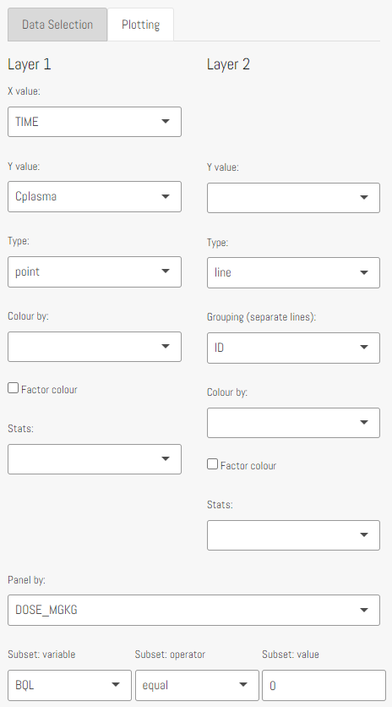
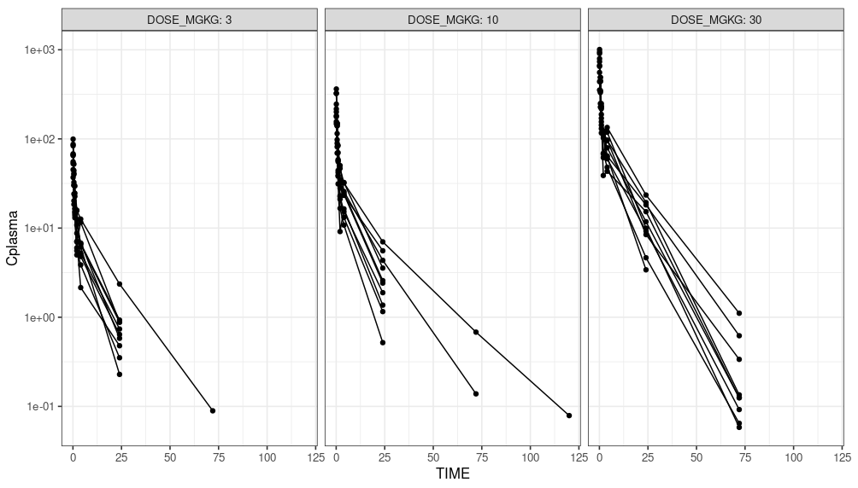
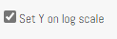
Step 1a
Variability between animals and measurement error
No signs of non-linearity

Slide 18
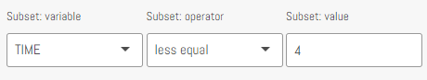
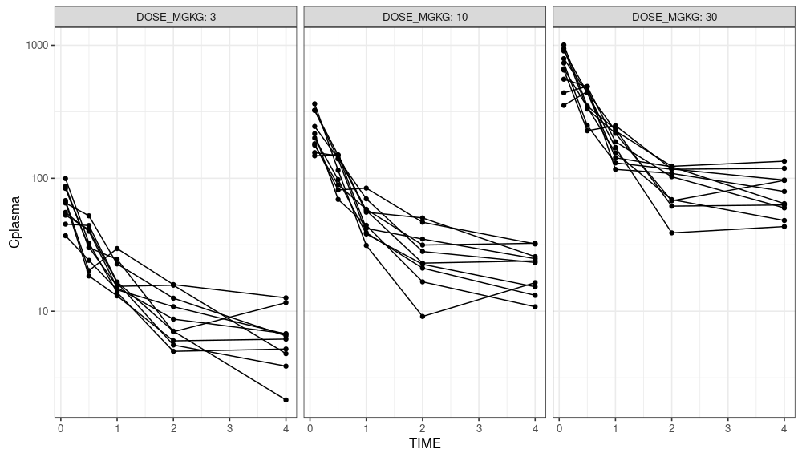
Step 1a
Zoom 4h: clear distribution phase

Slide 19
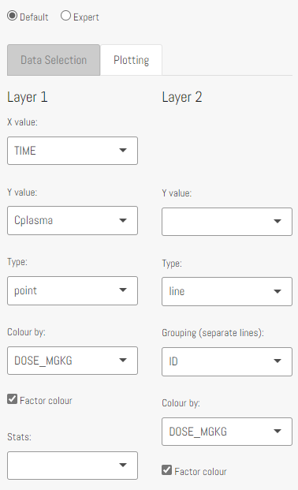
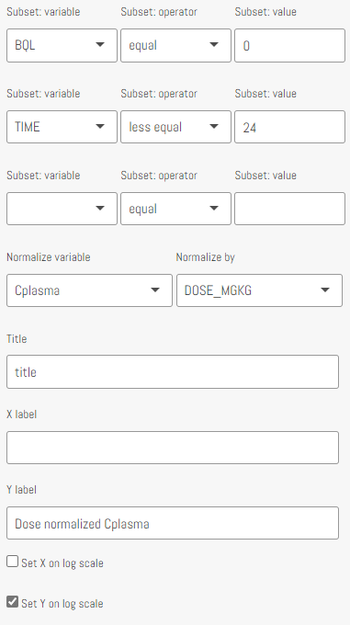
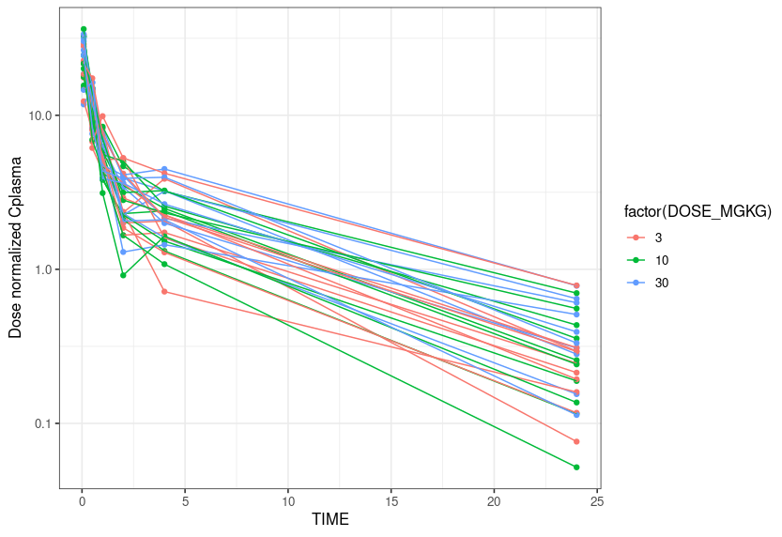
Step 1a
24h subset: Dose normalized Cplasma

Slide 20
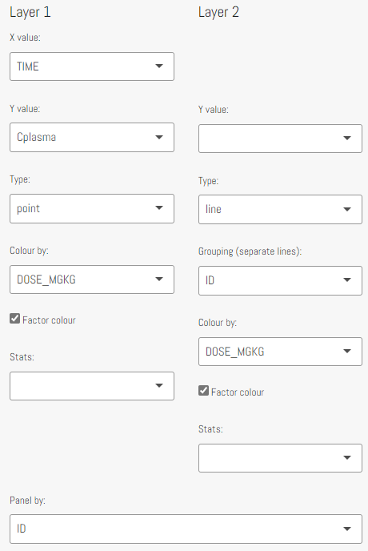
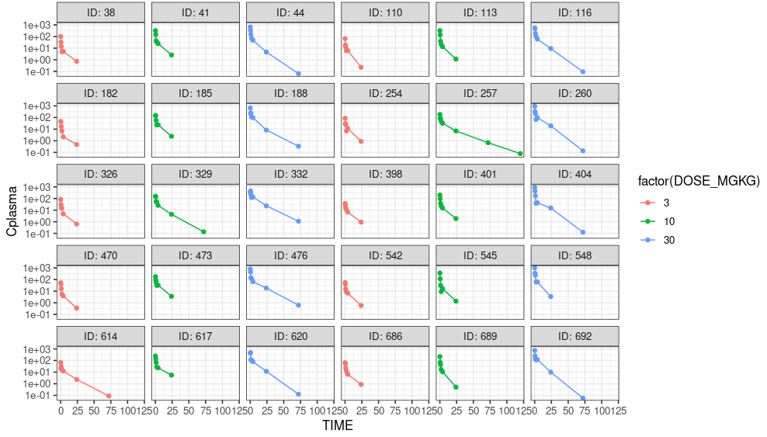
Step 1a
Individual plots

Slide 21
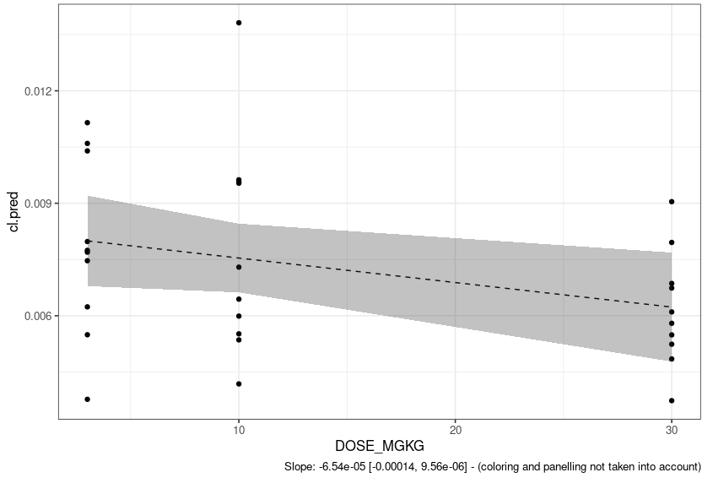
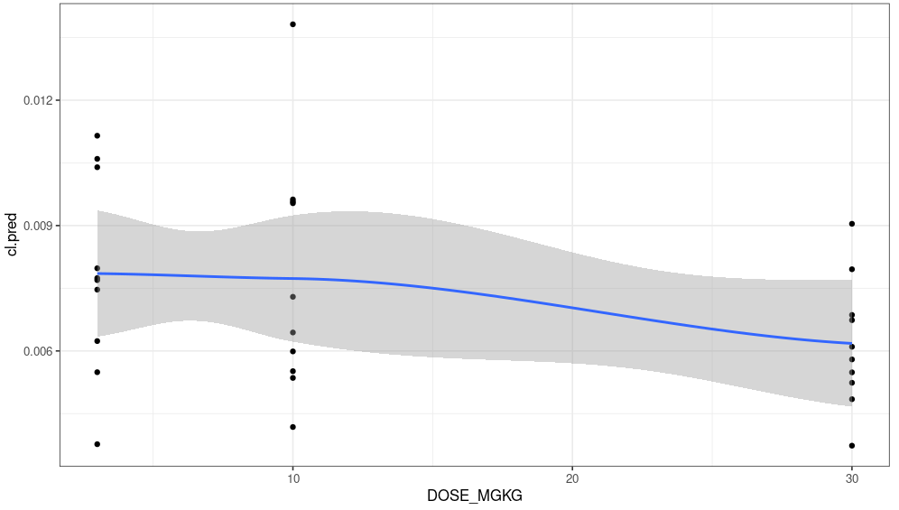
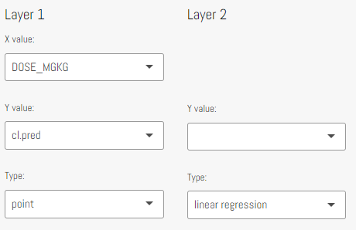
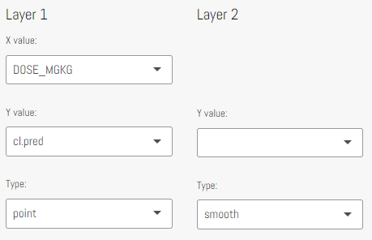
Step 1a
No signs of non-linearity: e.g. 95% Confidence interval of slope of linear regression contains 0
Estimate [95% CI]

Slide 22
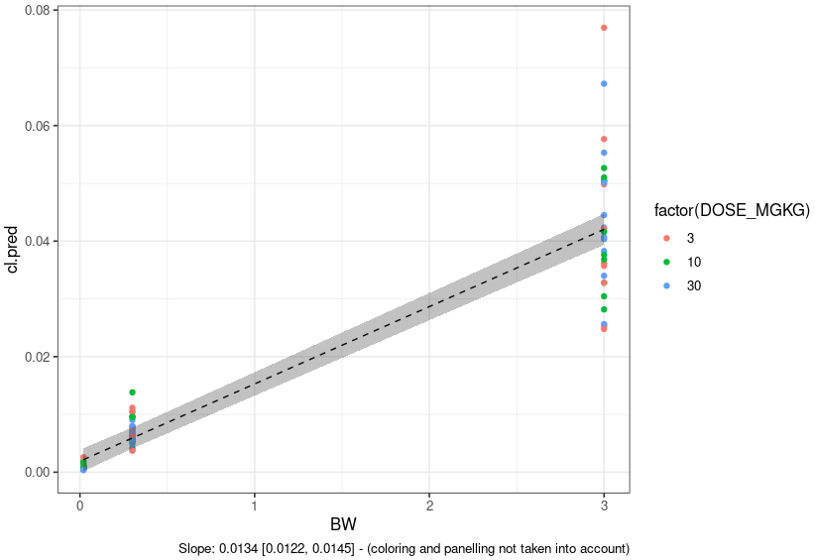
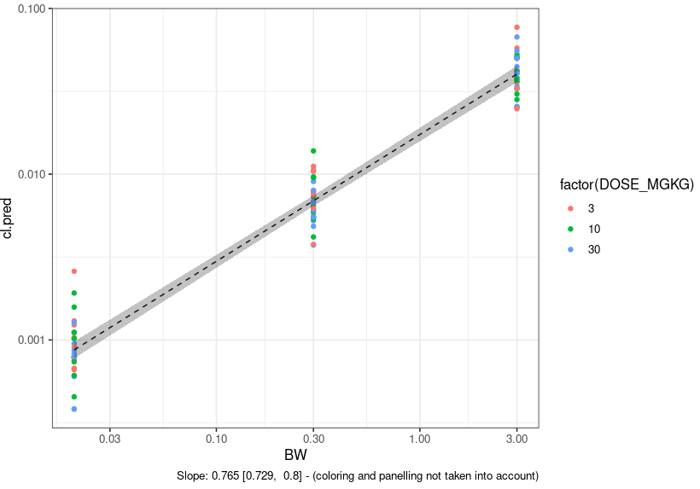
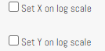
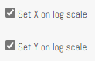
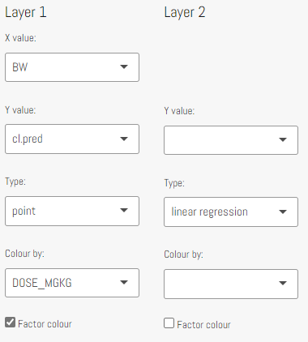
Step 1b
CL: lin-lin plot
CL: log-log plot → Slope is exponent of power relationship → Scaling: CL_{human} = CL_{monkey} * (BW_{human}/BW_{monkey})^{0.75}

Slide 23
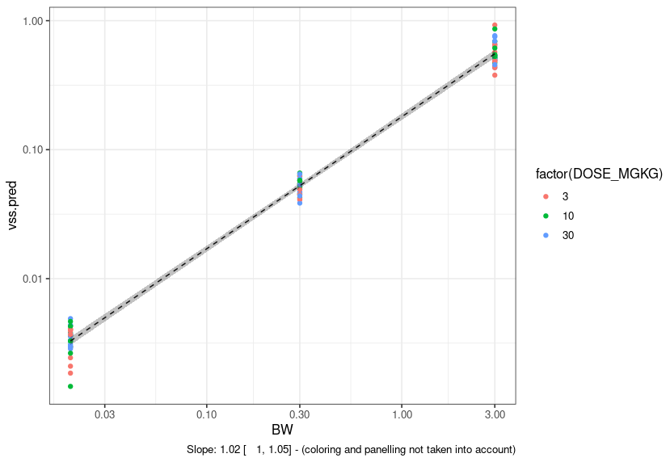
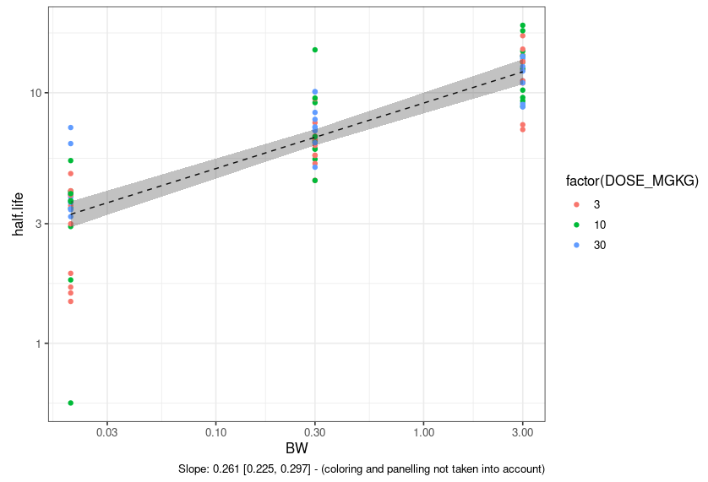
Step 1b
Vss: Slope = 1.02 = Allometric scaling coefficient → Scaling: V_{human} = V_{monkey} * (BW_{human}/BW_{monkey})¹
t_{1/2}: Slope = 0.261 = Allometric scaling coefficient
Coefficients V – CL ≈ 1 - 0.75 = 0.25

Slide 24
Step 2: Compare effect of administration routes on PK
Additional information
1 week study; 3, 10, 30 mg/kg
Step 2
Explore and discuss: Compare PK profiles / NCA results between administration routes
Bonus – Step 2
Discuss: impact of sampling schedule on NCA results
 | Drug | Study Type | Dosing | Species | Exploration datasets
Step 2 | SM | PK | IV/PO Single dose | Rat | Data: sm_rat_pk_ivpo_sd.csv NCA: sm_rat_nca_ivpo_sd.csv

Slide 25
Step 2: Compare effect of administration routes on PK
Additional information
1 week study; 3, 10, 30 mg/kg
Step 2
Explore and discuss: Compare PK profiles / NCA results between administration routes
Bonus – Step 2
Discuss: impact of sampling schedule on NCA results → Hint: Focus on Cmax
 | Drug | Study Type | Dosing | Species | Exploration datasets
Step 2 | SM | PK | IV/PO Single dose | Rat | Data: sm_rat_pk_ivpo_sd.csv NCA: sm_rat_nca_ivpo_sd.csv

Slide 26
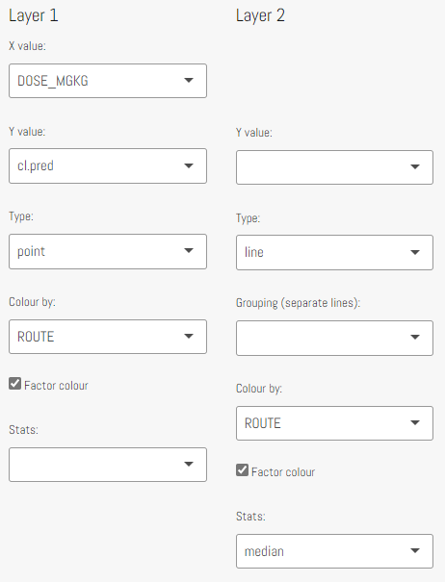
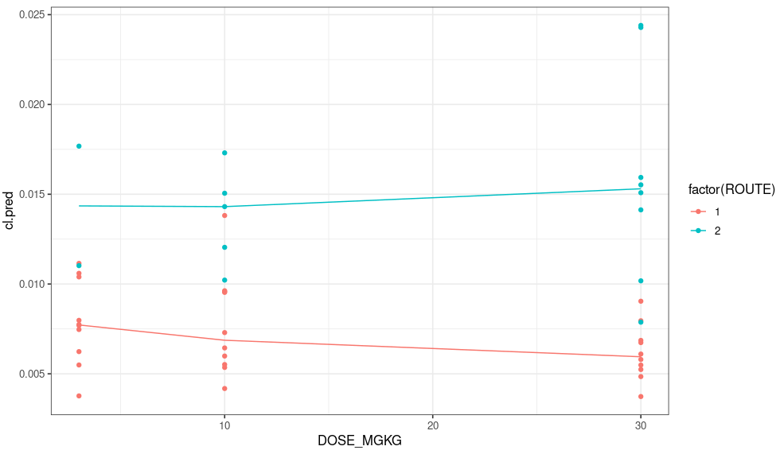
Step 2
Clearance larger for oral dosing, indicating a bioavailability lower than 1

Slide 27
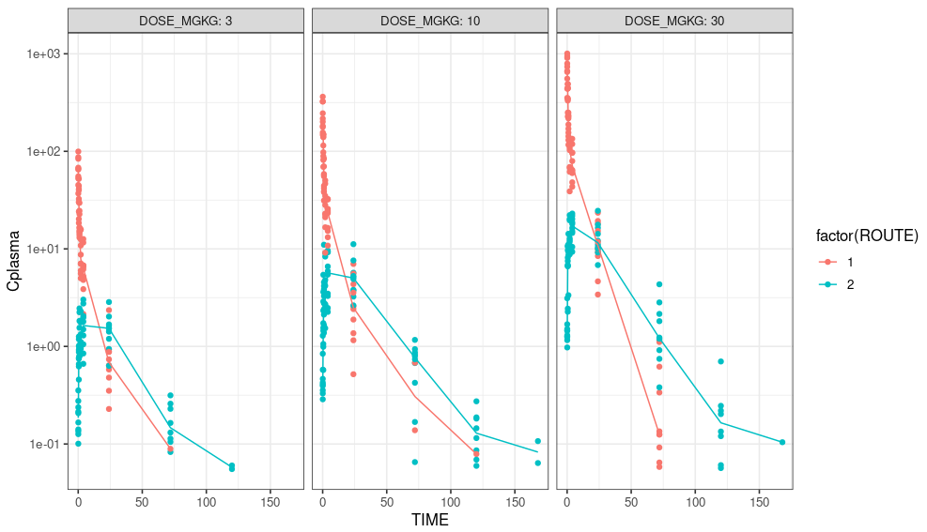
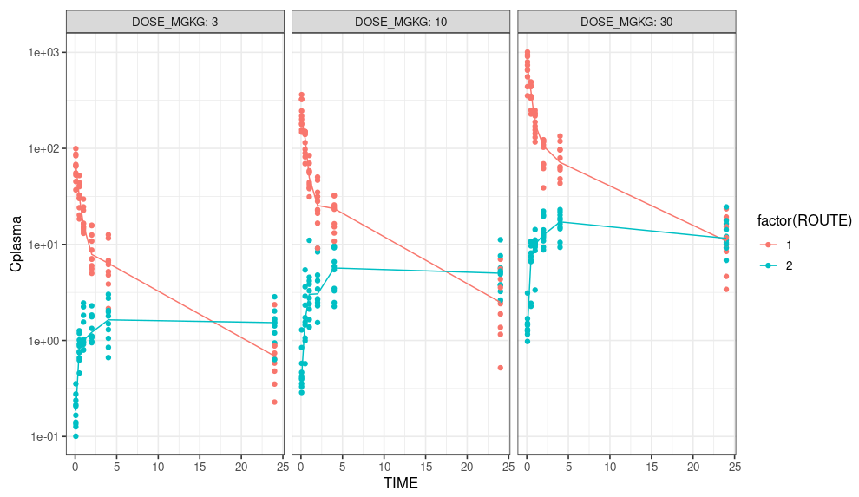
Step 2
Absorption controlled kinetics: absorption slower than elimination
Left: complete profile; Right: zoom in on first day; Line: median
Careful with interpreting Cmax from NCA results: poor sampling design

Slide 28
Step 3: inter-species PK variability for mAbs and its causes
Additional information
2 week study; 3, 10, 30 mg/kg
Step 3: Explore based on PK profiles / NCA results:
Discuss: Compare results between doses in monkey
Discuss: Compare results in terms of species differences between monkey and rat
Bonus – Step 3
Generate hypotheses regarding differences between individual animals
Are there predictors of this variability in the dataset?
 | Drug | Study Type | Dosing | Species | Exploration datasets
Step 3 | mAb | PK | IV Single dose | Rat, Monkey | Data: mab_trans_pk_iv_sd.csv NCA: mab_trans_nca_iv_sd.csv

Slide 29
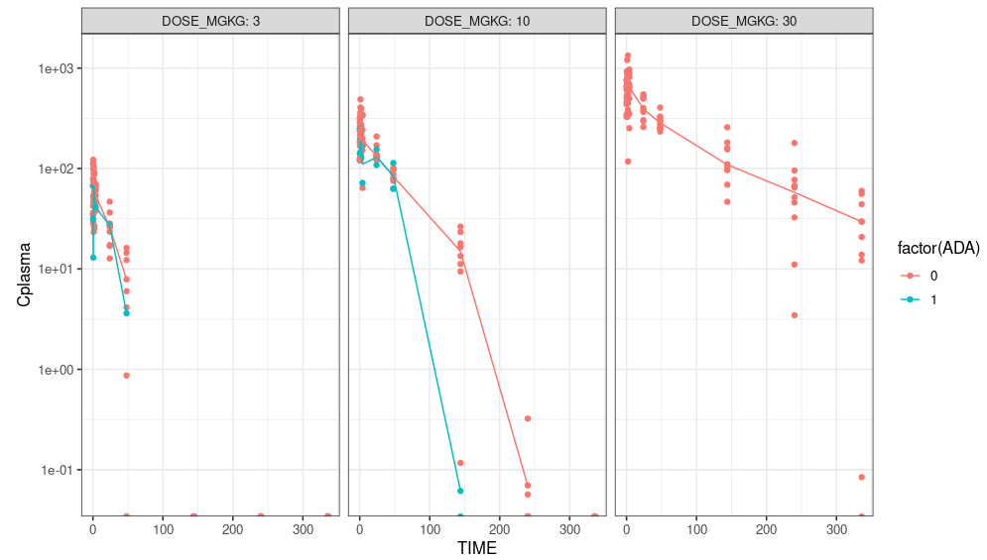
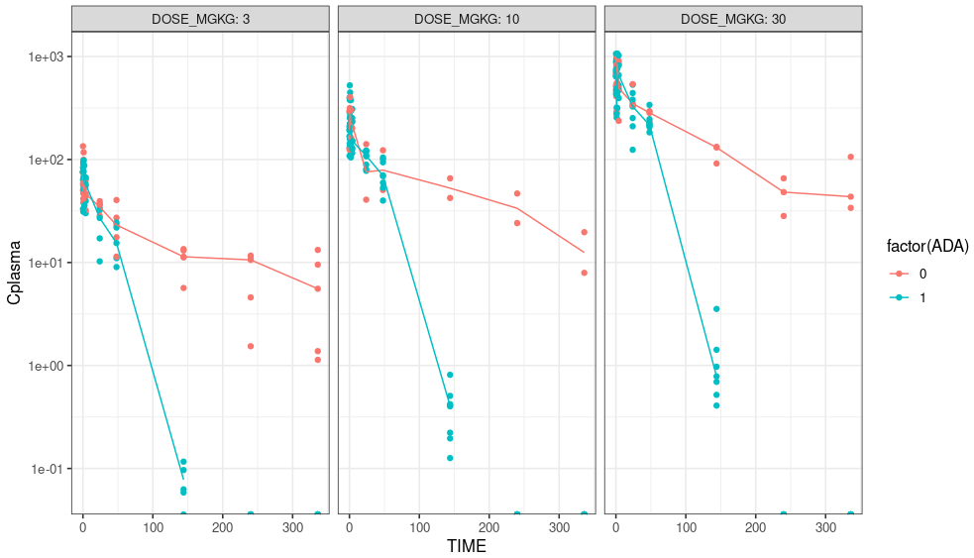
Step 3
Left: “Monkey” subset; Right: “Rat” subset; Lines: median
For this mAb: probability of ADA appears higher for rat vs monkeys
ADA appear to be clearing: Drug eliminated faster after a couple of days → Time dependent kinetics
For the ADA negative monkeys: elimination increases at lower concentration → TMDD: concentration dependent kinetics
No TMDD apparent for ADA negative rats → Species differences in target expression/turnover?

Slide 30
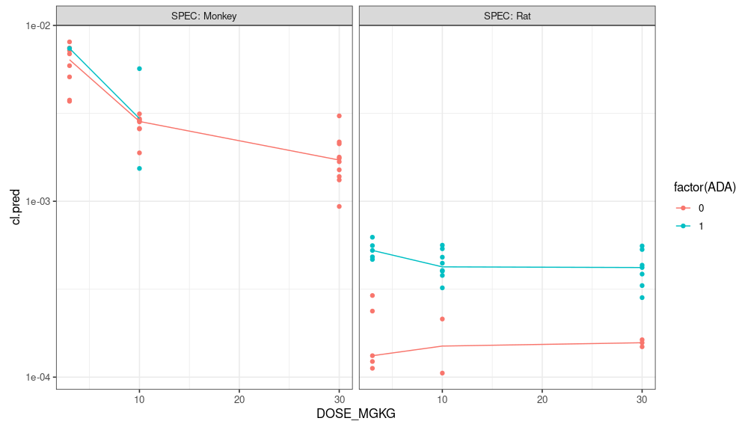
Step 3
Left: “Monkey” subset; Right: “Rat” subset; Lines: median
NCA can be useful, but comes with limitations → interpret with caution
Picking up / interpreting concentration and time dependencies is difficult
Assumes a single CL per animal, derived from dose/AUC

Slide 31
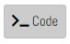
Step 4: Translational PKPD
 | Drug | Study Type | Dosing | Species | Exploration datasets
Step 4 | SM + MAB | PKPD | PO/SC Q2D | Rat, Monkey | Data: trans_pkpd_q2d_long.csv; trans_pkpd_q2d_wide.csv
Additional information
2w study; 3/10/30 mg/kg q2d dosing: Plasma PK + terminal brain PK sampling; PD: two biomarkers: efficacy and safety
2 datasets contain same information but structured differently, depending on plot of interest dataset can be selected
Long: values of all variables in DV column; TYPE column specifies variable
Wide: each variable as a separate column
Step 4
Explore Plasma vs brain PK results between compounds / doses / species
Explore Safety and Efficacy biomarker results between compounds / doses / species
Bonus – Step 4
Explore expert plotting option→ In general tab: multiple panelling, subsetting and transformation options available
Underlying R code can be explored via:
Discuss: impact of time point selection
Discuss: anticipated recommended safe/efficacious clinical dosing regimen per compound

Slide 32
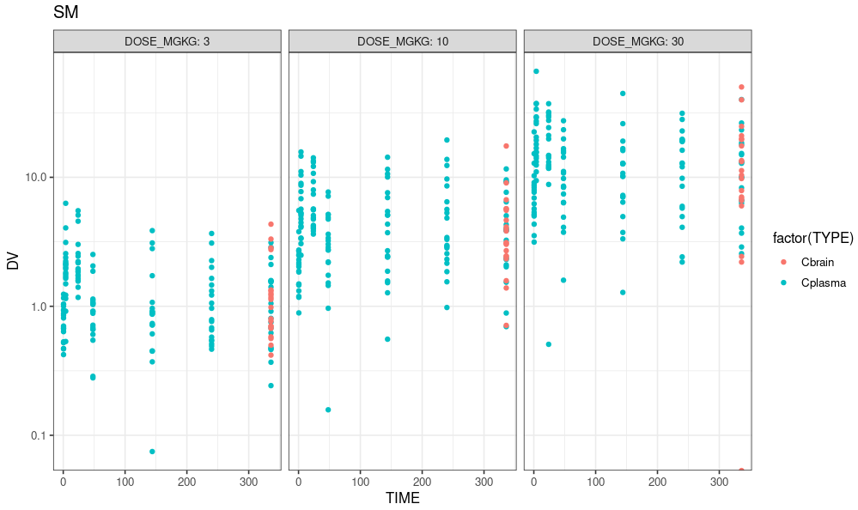
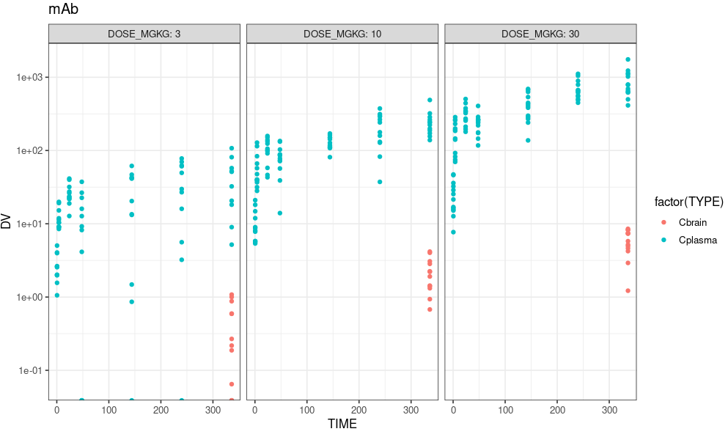
Step 4: Plasma versus brain PK
For SM, Cbrain and Cplasma similar levels → For mAb relatively low Cbrain vs Cplasma: indicating distribution mAb issue

Slide 33
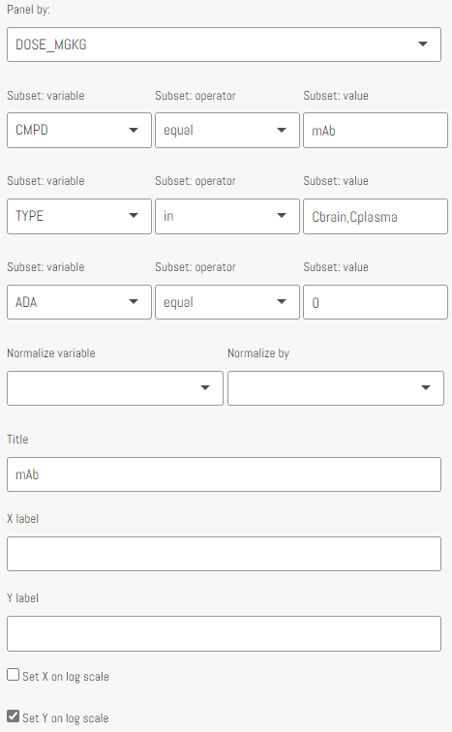
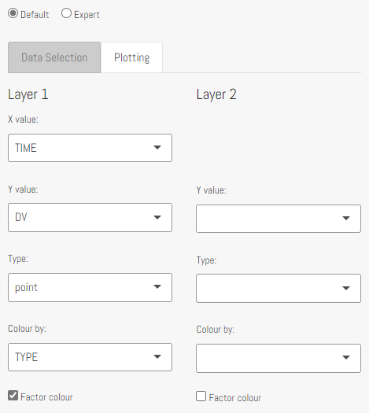
Step 4: Plasma versus brain PK
Settings previous slide - long dataset:

Slide 34
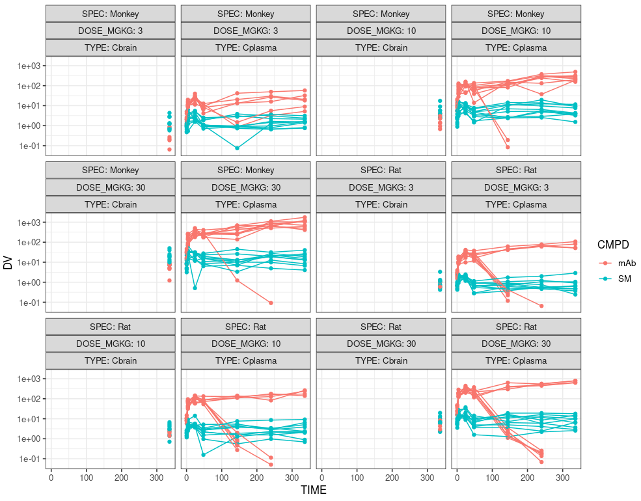
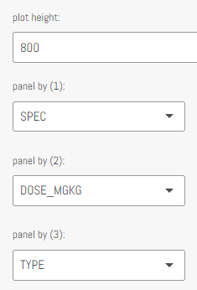
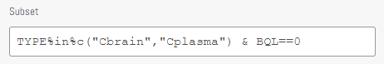
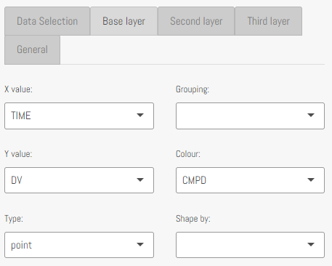
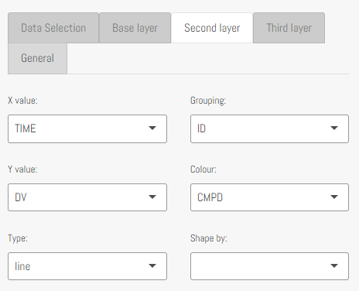
Step 4: Plasma versus brain PK
Alternative via expert option
Careful: ADA positive animals bias results
→ Can be subsetted out: “& ADA==0”
Long dataset:

Slide 35
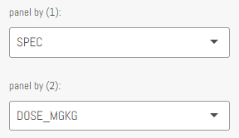
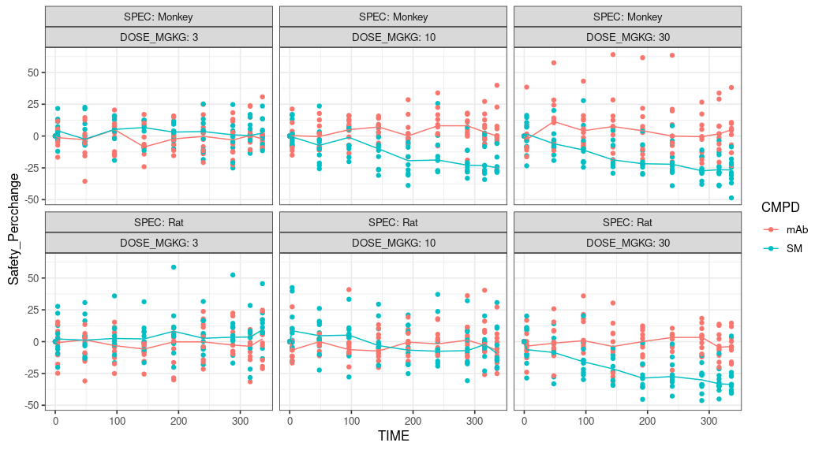
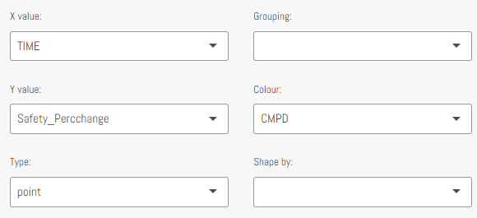
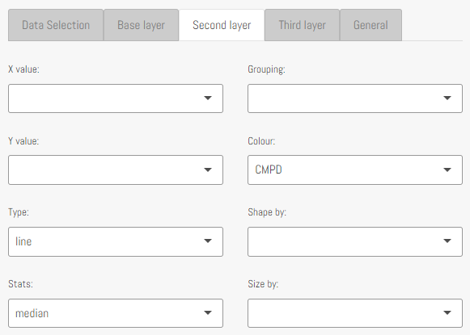
Step 4: Safety biomarker
Long dataset – Expert settings:
Safety: dose response for SM, but signal unclear for mAb
Careful: ADA positive animals impact PKPD
Long delay:
PKPD

Slide 36
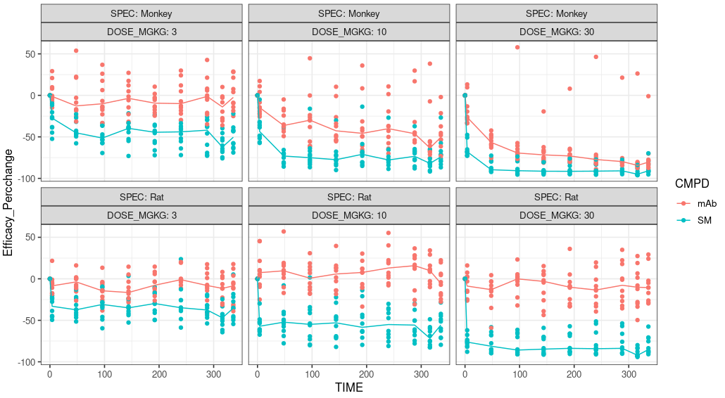
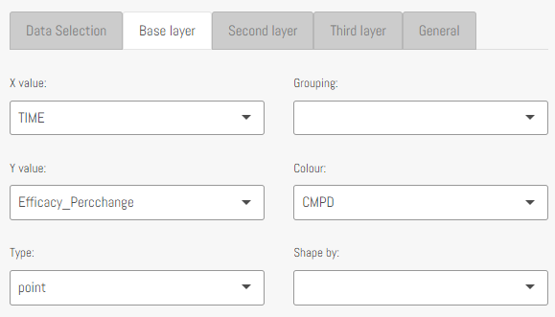
Step 4: Efficacy biomarker
Long dataset – Expert settings:
Efficacy: clear dose response → effect for both compounds in monkeys, despite inherent variability
Effect unclear for mAb in rats → Recall: also no TMDD → Different target expression/turnover/engagement → less effective in rat
Careful: ADA positive animals impact PKPD
Shorter delay PKPD,
Daily troughs lower effect

Slide 37
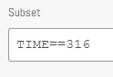
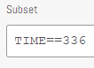
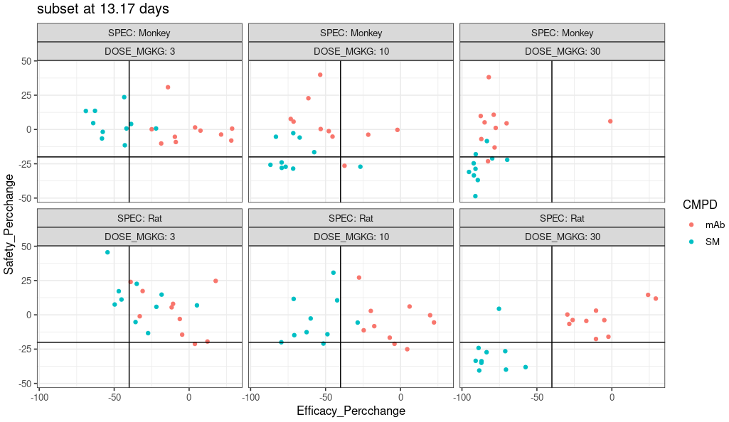
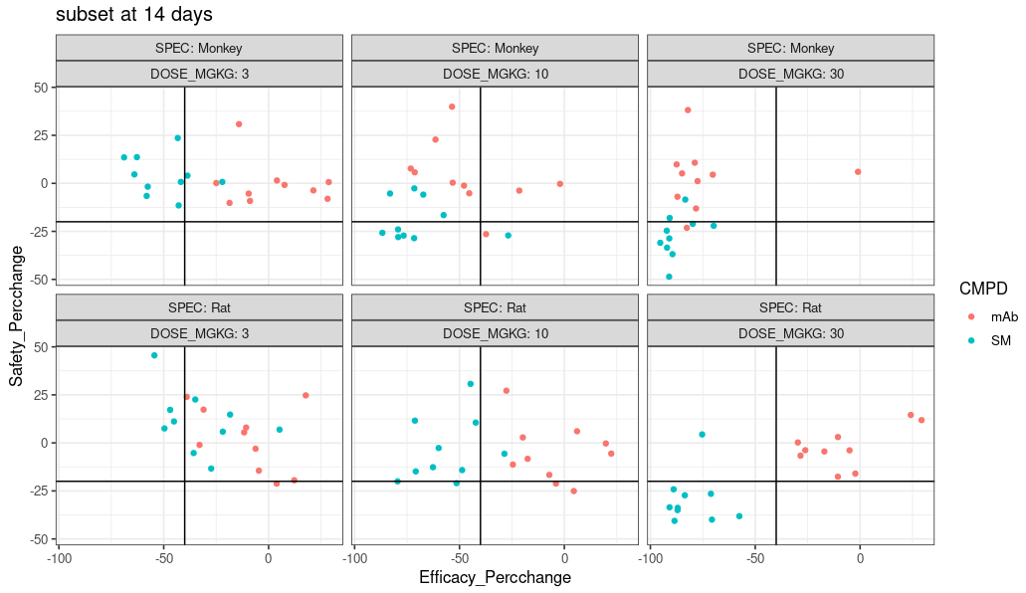
Step 4: Efficacy vs Safety
Long dataset – Expert settings:
Based on arbitrary desired response lines
>3 mg/kg undesired for SM (safety signal)
<10-30 mg/kg undesired for mAb (poor efficacy)
Note: signal can differ within a dosing interval (plots for 2 timepoints), depending on delay between exposure and response

Slide 38
Underlying PKPD dynamics

Slide 39
General model scheme
PK model component
PKPD relationship
PD model component
Dosing
Peripheral
Plasma
Ctissues
Distribution
Cplasma
Effect
Cplasma
K_{in,safety}
K_{out,safety}
Safety marker
Distribution
Partitioning coefficient
Elimination
Effect
Cbrain
K_{in,efficacy}
K_{out,efficacy}
Cbrain
Efficacy marker
Brain

Slide 40
Model scheme: specifics
Implemented drug differences
Specific set of PK parameters per compound (and additional non linear clearance for mAb)
Safety signal specific for the small molecule (reflecting binding to “1B” receptor)
Brain/Plasma partitioning coefficient is 100x lower for mAb vs small molecule
Steady state brain concentrations lower vs plasma for mAb, efficacy effect implemented as function of brain concentration
Brain conc to effect relationship is implemented as identical between compounds (note: same EC50 in µg/mL, not molar scale)
Implementated species differences
Volumes increase proportionally with body weight
Clearances/flows increase less than proportionally with body weight with allometric coefficient of 0.75 (Note: mAb literature 0.8-0.9)
Biomarker elimination rate constants decrease with body weight, with allometric coefficient of -0.25
For mAb
0/10/50% ADA chance for human/monkey/rodents, respectively (additional strong clearance after 3 days)
Combined saturable and linear clearance for human/monkey (reflecting mAb target mediated disposition)
Apparent linearity in rodents (reflecting poor rodent cross reactivity)
Implemented assay error and inter individual variability in PK and PD parameters to reflect real life situation

Slide 41
PKPD model – assumptions for human projections
Assumptions, in absence of any (literature/inhouse) information
Volumes/Clearances/flows/PD elimination rate constants increase with body weight (previous slide)
Absorption parameters in monkeys ≈ humans
mAb PK non linearity
KM in monkeys ≈ humans
Vmax scales with body weight similar to clearance
Concentration – Safety and Efficacy effect relationships in monkeys ≈ humans

Slide 42
Human predictions – Anticipated proof of concept

Slide 43


PKPD model – human projections

Slide 44


PKPD model – human projections

Slide 45
Human predictions – Human starting dose support

Slide 46
Approach for First in human (FIH) dose
Some definitions for FIH dose selection
Safety (preclinical)
NOAEL = No observed adverse event level
HNSTD = Highest non-severely toxic dose (managable toxicity)
Efficacy (preclinical)
MABEL = minimal antipated biological effect level
Dose projections
HED = human equivalent dose (Safety)
PAD = pharmacologically active dose (Efficacy)
MRSD = maximum recommended starting dose
Antagonists versus agonists
EC₅₀ for antagonists in MABEL assesments (system suppression)
Cavg may be used
For agonists, EC₁₀ or EC₂₀ is more applicable (system activation)
Cmax is more applicable as saftey hazards are a reality
(e.g. Cytokine Release Syndrome - TGN1412: From Discovery to Disaster, Attarwala (2010) J Young Pharm. 2(3): 332–336)

Slide 47
Starting dose discussion – example for our discussed mAb
mAb Additional information
Human projected dose regimen: weekly sc
4 weekly sc repeated tox in cyno: NOAEL established at 100 mg/kg (no issues at highest dose tested)
In vitro potency assay similar between cyno and human, no species differences of note
Team considers reaching average first-week plasma concentrations around EC50 as good low effect starting dose, for this antagonist
Every case is different, and potentially requires different approach
Agonist: consider e.g. 20% receptor occupancy or anticipated activity for relevant marker(s) (e.g. Cytokine release assay)
Consider what exposure metric is most relevant, Cmax versus Caverage
Consider protein binding species differences for small molecules / peptides
Account for other anticipated species differences where applicable
FIH in patients (oncology): avoid too low starting dose (sub-pharmacological)

Slide 48
Examples FDA oncology analyses: case by case
CD3 bispecific constructs
Approaches based on receptor occupancy, highest non-severely toxic dose, or no-observed adverse effect level are not acceptable for selecting the FIH dose as they resulted in doses close to or above the MTDs, HHDs, or the RHD.
A FIH dose corresponding to 10%-30% pharmacologic activity (PA) was an acceptable approach.
Antibody-drug conjugates
a FIH dose that is 1/6th the highest non-severely toxic dose (HNSTD) in cynomolgus monkeys or 1/10th the STD10 in rodents scaled according to body surface area (BSA) generally resulted in the acceptable balance of safety and efficient dose-escalation in a Phase 1 trial.
Immune activating antibodies
For approximately half the antibodies (44%) examined, the FIH doses were at least a hundred-fold lower than the doses safely administered to patients, indicating optimization of FIH dose selection and/or optimization of dose-finding trial design is needed to minimize patient exposure to sub-therapeutic doses.
However, selection of the FIH dose for antibodies based on animal toxicology studies using 1/6th the HNSTD or 1/10th the NOAEL resulted in human doses that were unsafe for several antibodies examined.
We employed two methods for computing the FIH dose; FIH doses based on 20%-80% PA, and those based on 20%-80% RO. The FIH doses computed based on 20%-80% PA had acceptable toxicities for all antibodies examined, which included checkpoint inhibitors and stimulators. For the purpose of this research, “acceptable toxicities” refers to no drugrelated death, no CRS/IRR greater than Grade 3 (per the National Cancer Institute Common Toxicity Criteria for Adverse Events (CTCAE)), and overall manageable toxicities. The range of potential FIH doses was large for a specific product when EC50s had a large range. FIH doses based on 20%-80% RO also had acceptable toxicities for all antibodies examined.
Note: appears high, but keep in mind: Cmax method used

Slide 49


Starting dose discussion – example for our discussed mAb
Model independent methods
NOAEL-based HED: BSA-based with safety margin of 10
100 mg/kg * 0.32 / 10 = 3.2 mg/kg
“Starting dose is recommended to be lower than 3.2 mg/kg”
Note: no modeling needed, but careful – assumes that both linear and target mediated saturable clearance scale with BSA
Factor 0.32 for monkeys: see Table 1: FDA 2005 - Estimating the Maximum Safe Starting Dose in Healthy Volunteers
BSA-based: HED = animal NOAEL * (BW_{animal}/BW_{human})^{(1-0.67)} = monkey NOAEL * 0.32
Rowland and Tozer Clinical Pharmacokinetics and Pharmacodynamics Concepts and Applications - 4th ed.

Slide 50
Starting dose discussion – example for our discussed mAb
Model independent methods
Cmax-based MABEL: with 2.8 L plasma volume assumed for 70 kg volunteer
After iv (or sc with high ka & F), Cmax can be approximated by Dose / plasma volume
EC50 = 1 µg/mL → Corresponding dose = 1 mg/L * 2.8 L / 70 kg = 0.04 mg/kg
Note for any other pharmacological activity (PA), assuming a sigmoidicity of 1 in hill equation
E.g. PA 80% → Corresponding dose = (V/BW) * (PA*EC50/(1-PA)) = (2.8/70) * (0.8*EC50/(1-0.8)) = 0.16 mg/kg
“A starting dose of 0.04 mg/kg is anticipated to correspond with ≤50% activity”
No modeling needed, but with large peak to trough ratios anticipated PA at Cmax might lead to unnecessary low starting dose
Alternative, especially relevant for agonists (and for FIM in patients)
Similar calculations can be performed to predict receptor occupancy (RO), via binding affinity (KD), instead of EC50
Consider PA from multiple assays : T-cell activation, Cytotoxicity/lysis, Cell depletion, Cytokine release (IL2 , IFNg , TNFa)
Example: FDA-analysis paper - An FDA oncology analysis of immune activating products and first-in-human dose selection

Slide 51



Starting dose discussion – example for our discussed mAb
Model dependent methods
NOAEL-based HED: PK model derived exposure based with safety margin of 10
Instead of BSA based scaling, scaling factors estimated in PK modeling (if multi-preclinical species data available)
For our mAb, based on linear CL/flow scaling factor ≈ 0.75 (established, rat to monkey)
Non linearity: scaling very likely unknown → Sensitivity analysis advised
E.g. Vmax scales allometrically (0.75; our current assumption) or is body weight independent
Typical simulations performed
Cyno 100 mg/kg: AUC’s calculated and divided by 10 (safety margin)
Target AUC in human AUC_{inf,sd} = 18562 h*µg/mL AUC_{0,7d} = 11686 h*µg/mL AUC_{ss,qw} = 23800 h*µg/mL
Corresponding human doses: sd based: 10.9 mg/kg first week based: 8.8 mg/kg steady state based: 7.2 mg/kg
To achieve 10 fold lower exposure, less than 10 fold lower dose needed, even though lower clearance in human vs monkeys, since much higher clearance at lower concentrations due to non linearity

Slide 52


Starting dose discussion – example for our discussed mAb
Model dependent methods
Caverage-based MABEL
PK model vs in vitro EC50 and/or in vivo EC50 established by preclinical PKPD modeling
For our mAb: in vivo EC50 ≈ 2 µg/mL (2x higher than in vitro; Cbrain vs Cplasma KP ignored for simplicity – could be accounted for in real case); Note: Sigmoidicity can also be estimated in vivo for more reliable EC20 – EC80 calculation when needed
MABEL dose (in vitro EC50)
0.8 mg/kg
MABEL dose (in vivo EC50)
1.1 mg/kg
Note: not a lot of accumulation expected for this compound at these lower doses (due to non linearity) → First week or steady state week average concentrations similar

Slide 53
Starting dose discussion – example for our discussed mAb
Summary
NOAEL BSA assumed; model independent: 3.2 mg/kg
NOAEL PK model based: 7 - 11 mg/kg, depending on AUC choice (given a set of PK assumptions)
Cmax – in vitro EC50 based MABEL; model independent: 0.04 mg/kg
Caverage – in vitro/in vivo EC50 based MABEL; PK/PKPD model dependent: 0.8-1.1 mg/kg
Possible recommendation (pending other factors)
1 mg/kg starting dose
Note: similar calculations can be performed to assess the pharmacologically active dose

Slide 54
Addressed concepts

Slide 55
Overview of addressed concepts
Key concepts where PKPD modeling and simulation can support translational non clinical drug development
Data exploration to guide understanding PKPD behavior of different compounds
Acknowledge inherent inter/intra animal variability; search for predictors of variability
Absorption, distribution and (non-linear) elimination; impact of ADA on PKPD of mAbs
Inter-species allometric scaling
PKPD: assess delay between response and plasma concentration
Summarize and quantify non clinical knowledge within modeling framework to predict clinical PKPD
Support FIM dose selection using model (in-) dependent methods

